Slide 1
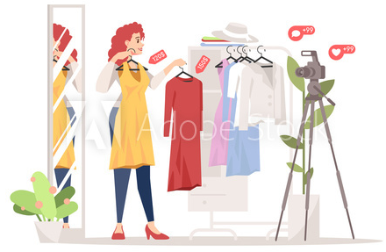
BDA Mini-Project Women’s Clothing E-commerce Reviews

Slide 2
Abstract
We have used Women’s Clothing E-Commerce Dataset to classify the reviews given by a customer as being Positive or Negative Review.
The Review given by the Customers can later be used to identify which of the products and dresses, the customers are liking or disliking and thereby help the company introduce relevant Dresses in the market.
The reviews have been written by customers purchasing from a particular brand.
It has nine supportive features which offer a great environment to parse out the text through its multiple dimensions.
This is real commercial data, has been anonymized, and references to the company in the review text and body have been replaced with “retailer”.

Slide 3
Details of Dataset used
This dataset includes 23486 rows and 10 feature variables. Each row corresponds to a customer review, and includes the variables:
Clothing ID: Integer Categorical variable that refers to the specific piece being reviewed.
Age: Positive Integer variable of the reviewers age.
Title: String variable for the title of the review.
Review Text: String variable for the review body.
Rating: Integer variable for the product score granted by the customer from 1 Worst, to 5 Best.
Recommended IND: Binary variable stating where the customer recommends the product where 1 is recommended, 0 is not recommended.
Positive Feedback Count: Positive Integer documenting the number of other customers who found this review positive.
Division Name: Categorical name of the product high level division.
Department Name: Categorical name of the product department name.
Class Name: Categorical name of the product class name

Slide 4
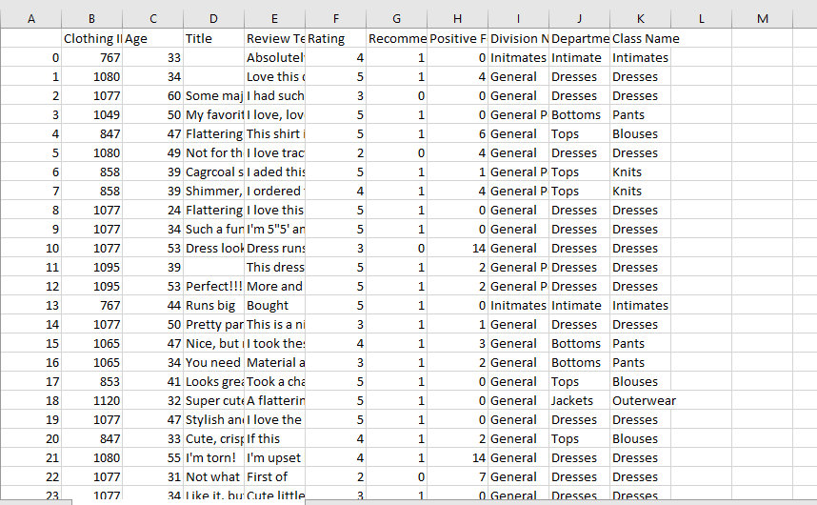
Screenshot of the Dataset
Link to the Dataset : https://www.kaggle.com/nicapotato/womens-ecommerce-clothing-reviews

Slide 5
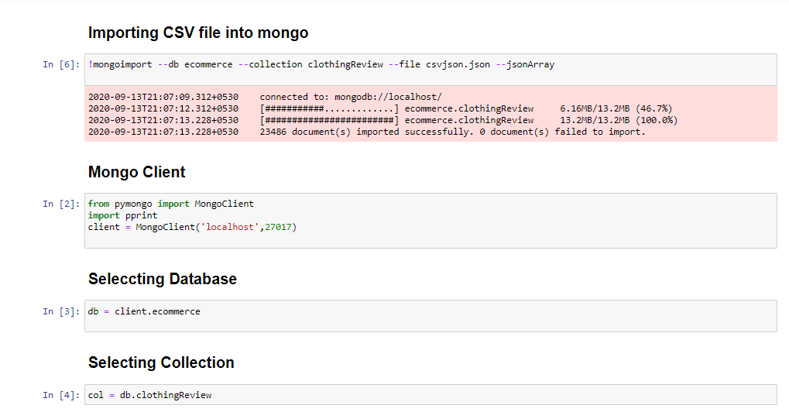
MongoDB Connection

Slide 6
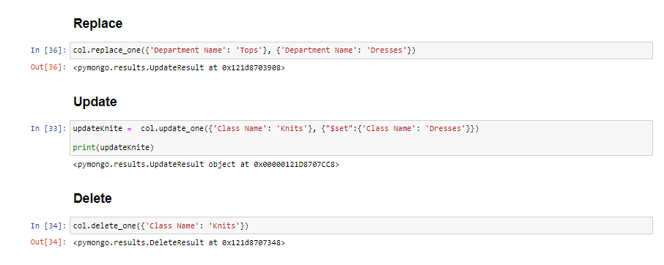
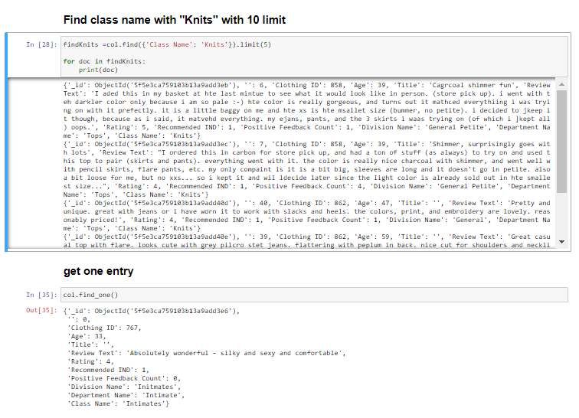

Slide 7
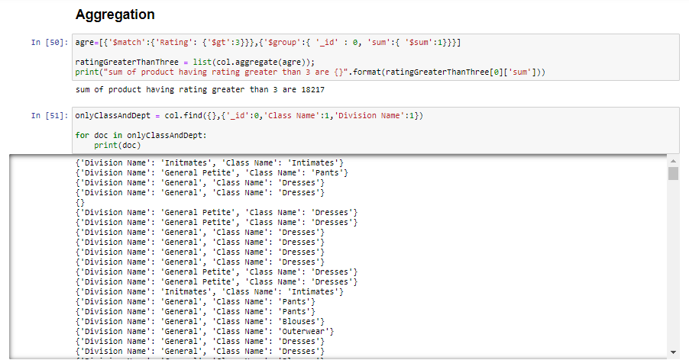

Slide 8
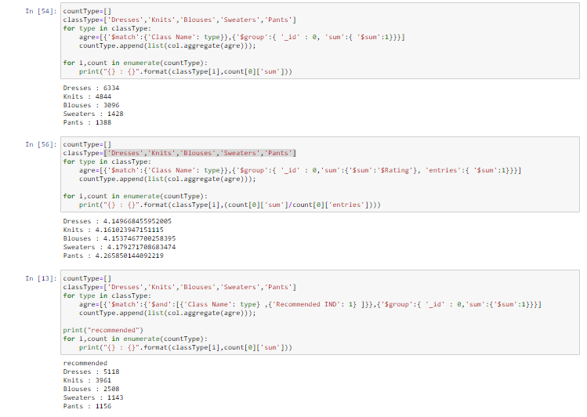

Slide 9
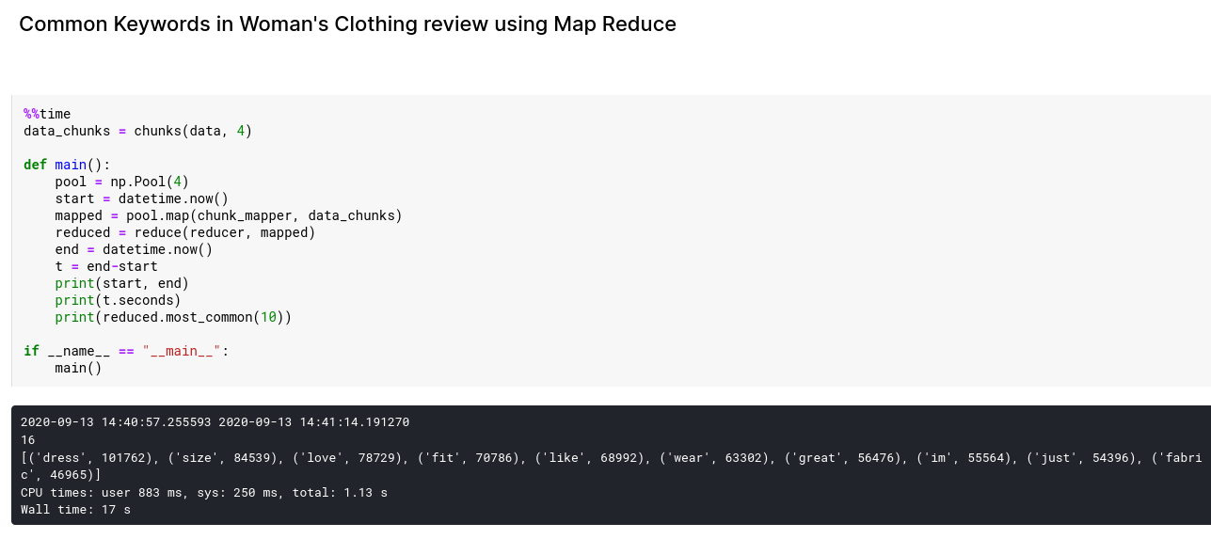
Performing Map Reduce on Database

Slide 10
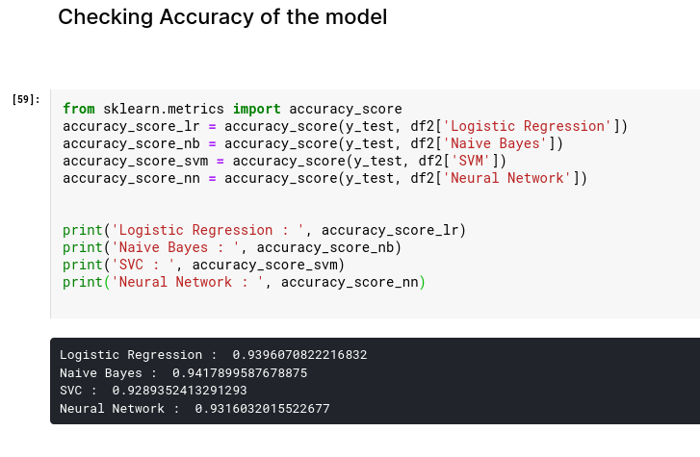


Comparative Analysis of ML Algorithms
Runtimes of Different Algorithms

Slide 11
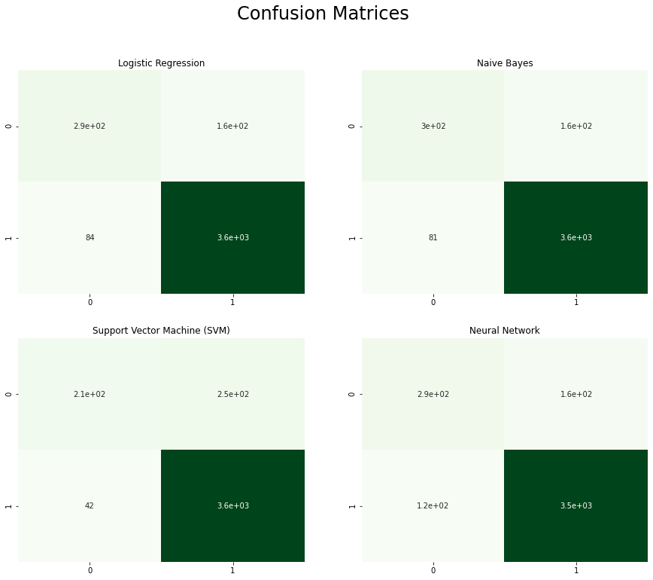
Confusion Matrix

Slide 12
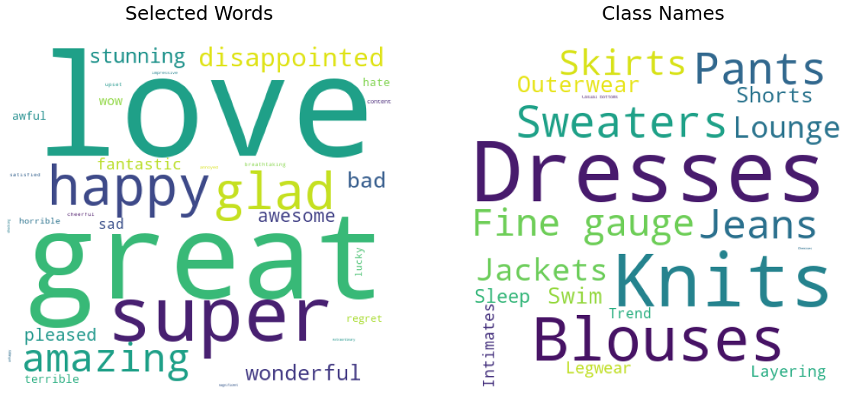
Word Cloud from the Reviews

Slide 13
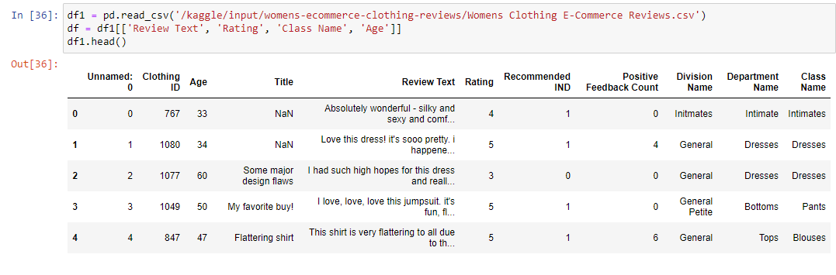
First 5 Columns

Slide 14

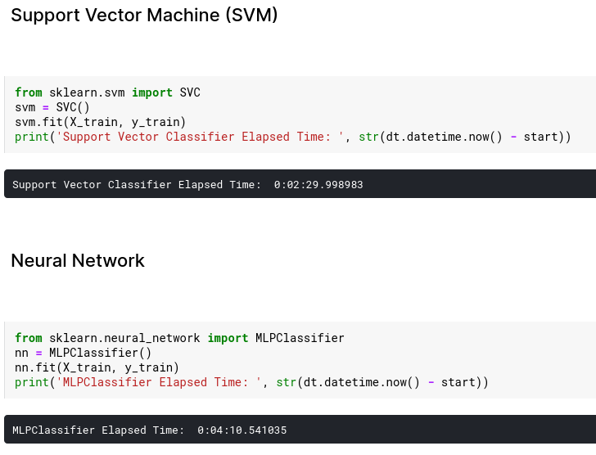
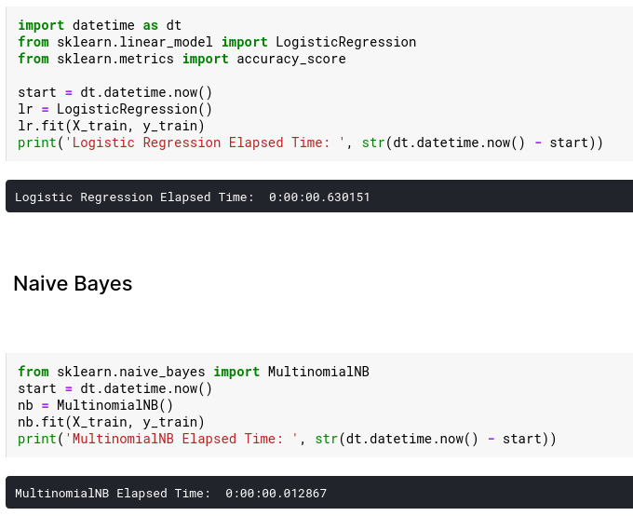
ML Algorithms Applied

Slide 15
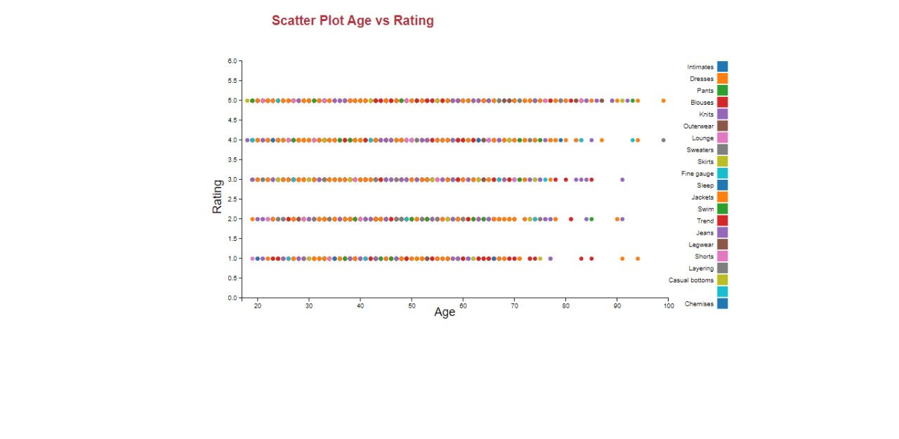
Visualization of Graphs using D3.js

Slide 16
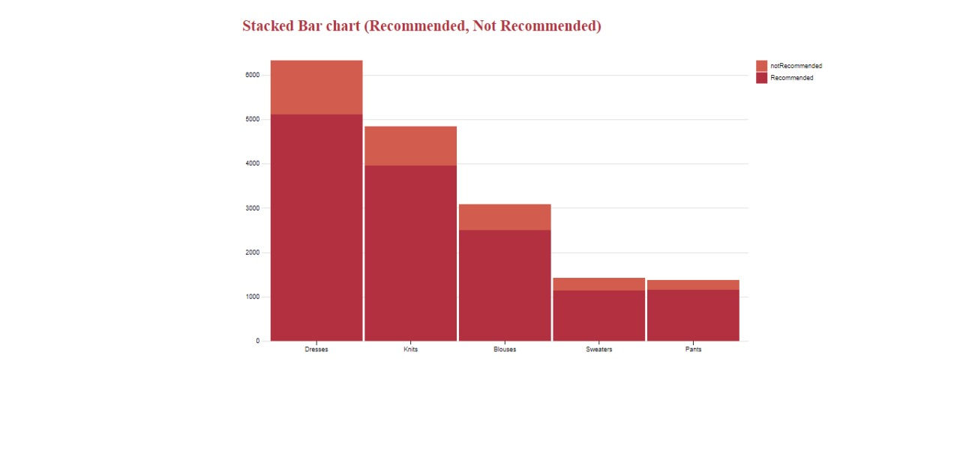
Recommended vs Not Recommended (D3.js)

Slide 17
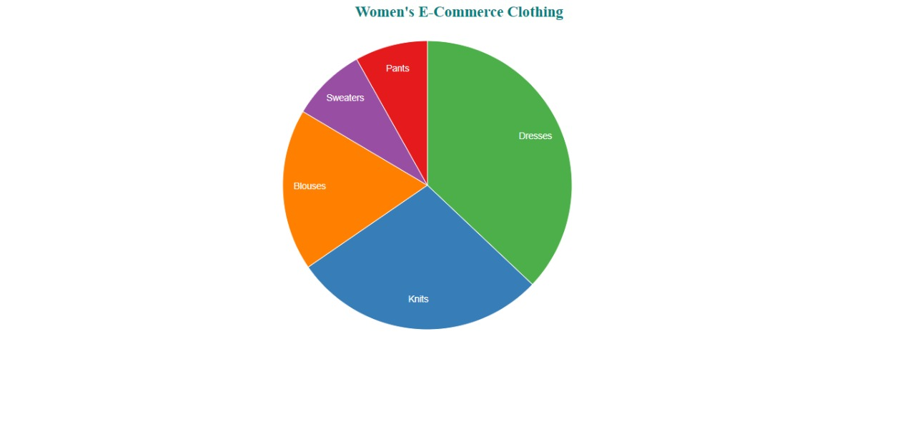
Distribution of Dresses across Categories (D3.js)

Slide 18
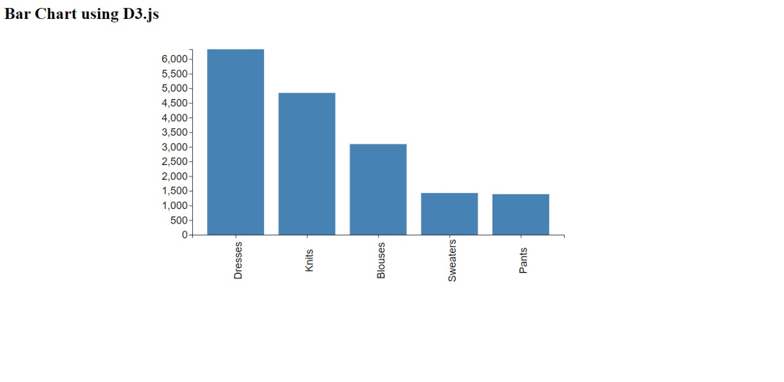
No. of Reviews vs Dresses (D3.js Visualizations)

Slide 19

Observations & Inference from Visualizations
There is more demand for Dresses, knits, blouses than any other garments.
Dresses are most recommended and selled.
Dresses and Blouses are buyed by all the aged group.

Slide 20
Conclusion
Implemented CRUD operations for Women's Clothing E-commerce, MongoDB as Backend.
Perform query retrieval operations such insert, update, insert, delete aggregation, etc
Logistic Regression, Naive Bayes, SVC, Neural Network ML Algorithm were implemented for comparative analysis and Naive Bayes works the best.
Bar chart, Pie chart, Scattered plot, Stacked Bar chart have been implemented on dataset using D3.js.

Slide 21

Thank You

